Slide 1

SMILE ☺
“Architecting Project Management for Business Transformation”
☺ Smart Measures In Live Engagement

Slide 2

Protocol
For convenience of each of us, lets practice and adhere to followings during the session
Keep the mobile in silent mode
  In case of emergency, use the corridor to receive the call
Park the question to end of session
  Feel free to utilize Q&A session
Use the break time for additional queries
  Mail us for any further clarification
Notes:
House rules

Slide 3

Mind Your Business
Business Sense – Balance Sheet
Business Turbulence - Symptoms
Project Governance
Best Practices
Notes:
Ice Breakers
SMILE - Sweet Memories In Lip Expressions

Slide 4

Project Managers do all that required to control the project execution
However SMILE is a practiced tool, giving results to business benefits.
A Successful Manager need to ensure a business continuity from the same Investors, by delivering stakeholder delight as an intangible benefit along Project deliverables.
In order to have the business continuity, the project manager can practice SMILE during the project execution which helps in passing the
benefit to investors.
S: Stakeholder Satisfaction
M: Maintain Profitability
I: Inculcate Scope Change
L: Lessons Learned
E: Early to Market
Notes:
Summary

Slide 5

… it’s all about the OOMPH factor
Hidden Expectation In Project Management
Intangible Benefit Spiral
Failure to Success Transformation
Brand Retention
Notes:
Problem statement

Slide 6


Managing Managers
Managers need to manage multiple managers
Functional Manager
Stakeholder
Contractor Manager
Project Manager
Technical Manager
Resource Manager
People Manager
Supervisor
Finance Manager

Slide 7


SMILE
L
P
E
O
E
Lessons
C
S
E
Project Life Cycle
C
G
I
H
A
N
Exec Exit
Exec Entry
OM
Infl Stkhldr
Supp Stkhldr
-ve Stkhldr
S
M
M

Slide 8
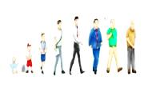
Continuous Improvement
Project Life Cycle
&
Impact
Analysis
Scope
Change
Competitor
Analysis
Exec Entry
Execution & Monitoring
Exec Exit
Stakeholder
Communication
Continuous
Monitoring
Change
Adaptation
&

Slide 9


Stake Holder Delight
H
Power
Keep Satisfied
Manage Closely
Monitor
Keep Informed
L
Interest
L
H
H
Power
Influential
Influential
Negative
Negative
Supportive
Supportive
L
Interest
L
H

Slide 10




Managing Profitability
Reusability
2. Expense Optimization
3. MUDA or reduction of waste
MUDA – Waste Management
Re-usability
Expense Optimization

Slide 11
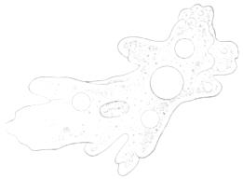

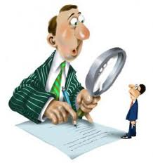
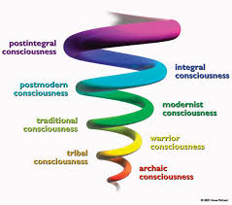
Inculcate Scope Change
Proactive Anticipation
Impact Analysis
Simultaneous Implementation

Slide 12


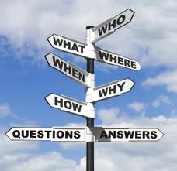

Learning …
Value Add on Learning
Knowledge Database
Talent Retention

Slide 13
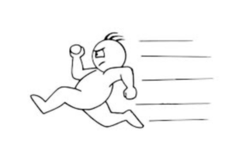




Early to Market
Competitor Analysis
Competitor Monitoring
Scope Control & Reconciliation
Effective Communication

Slide 14

… SMILE Process Diagram
Re-usable Component
Scope
Change
Feedback Form
M: Maintain
Profitability
I: Inculcate
Scope Change
S: Stakeholder
Satisfaction
L: Lessons
Learned
E: Early to
Market
Knowledge Base
Competitor Data Base

Slide 15

Conclusion
Stakeholder Satisfaction
Maintain Profitability
Inculcate Scope Change
Lessons Learnt
Early to Market

Slide 16

SMILE Please

Slide 17
⓪②③①

Slide 18
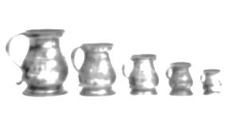
S
M
I
L
E

Slide 19

Project Managers do all that required to control the project execution
However SMILE is a practiced tool, giving results to business benefits.
A Successful Manager need to ensure a business continuity from the same
Investors, by delivering stakeholder delight as an intangible benefit along
Project deliverables.
In order to have the business continuty, the project manager can practice
SMILE (as below) during the project execution which helps in passing the
benefit to investors:
☺ S: Stakeholder Satisfaction
☺ M: Maintain Profitability
☺ I: Inculcate Scope Change
☺ L: Lessons Learned
☺ E: Early to Market

Slide 20
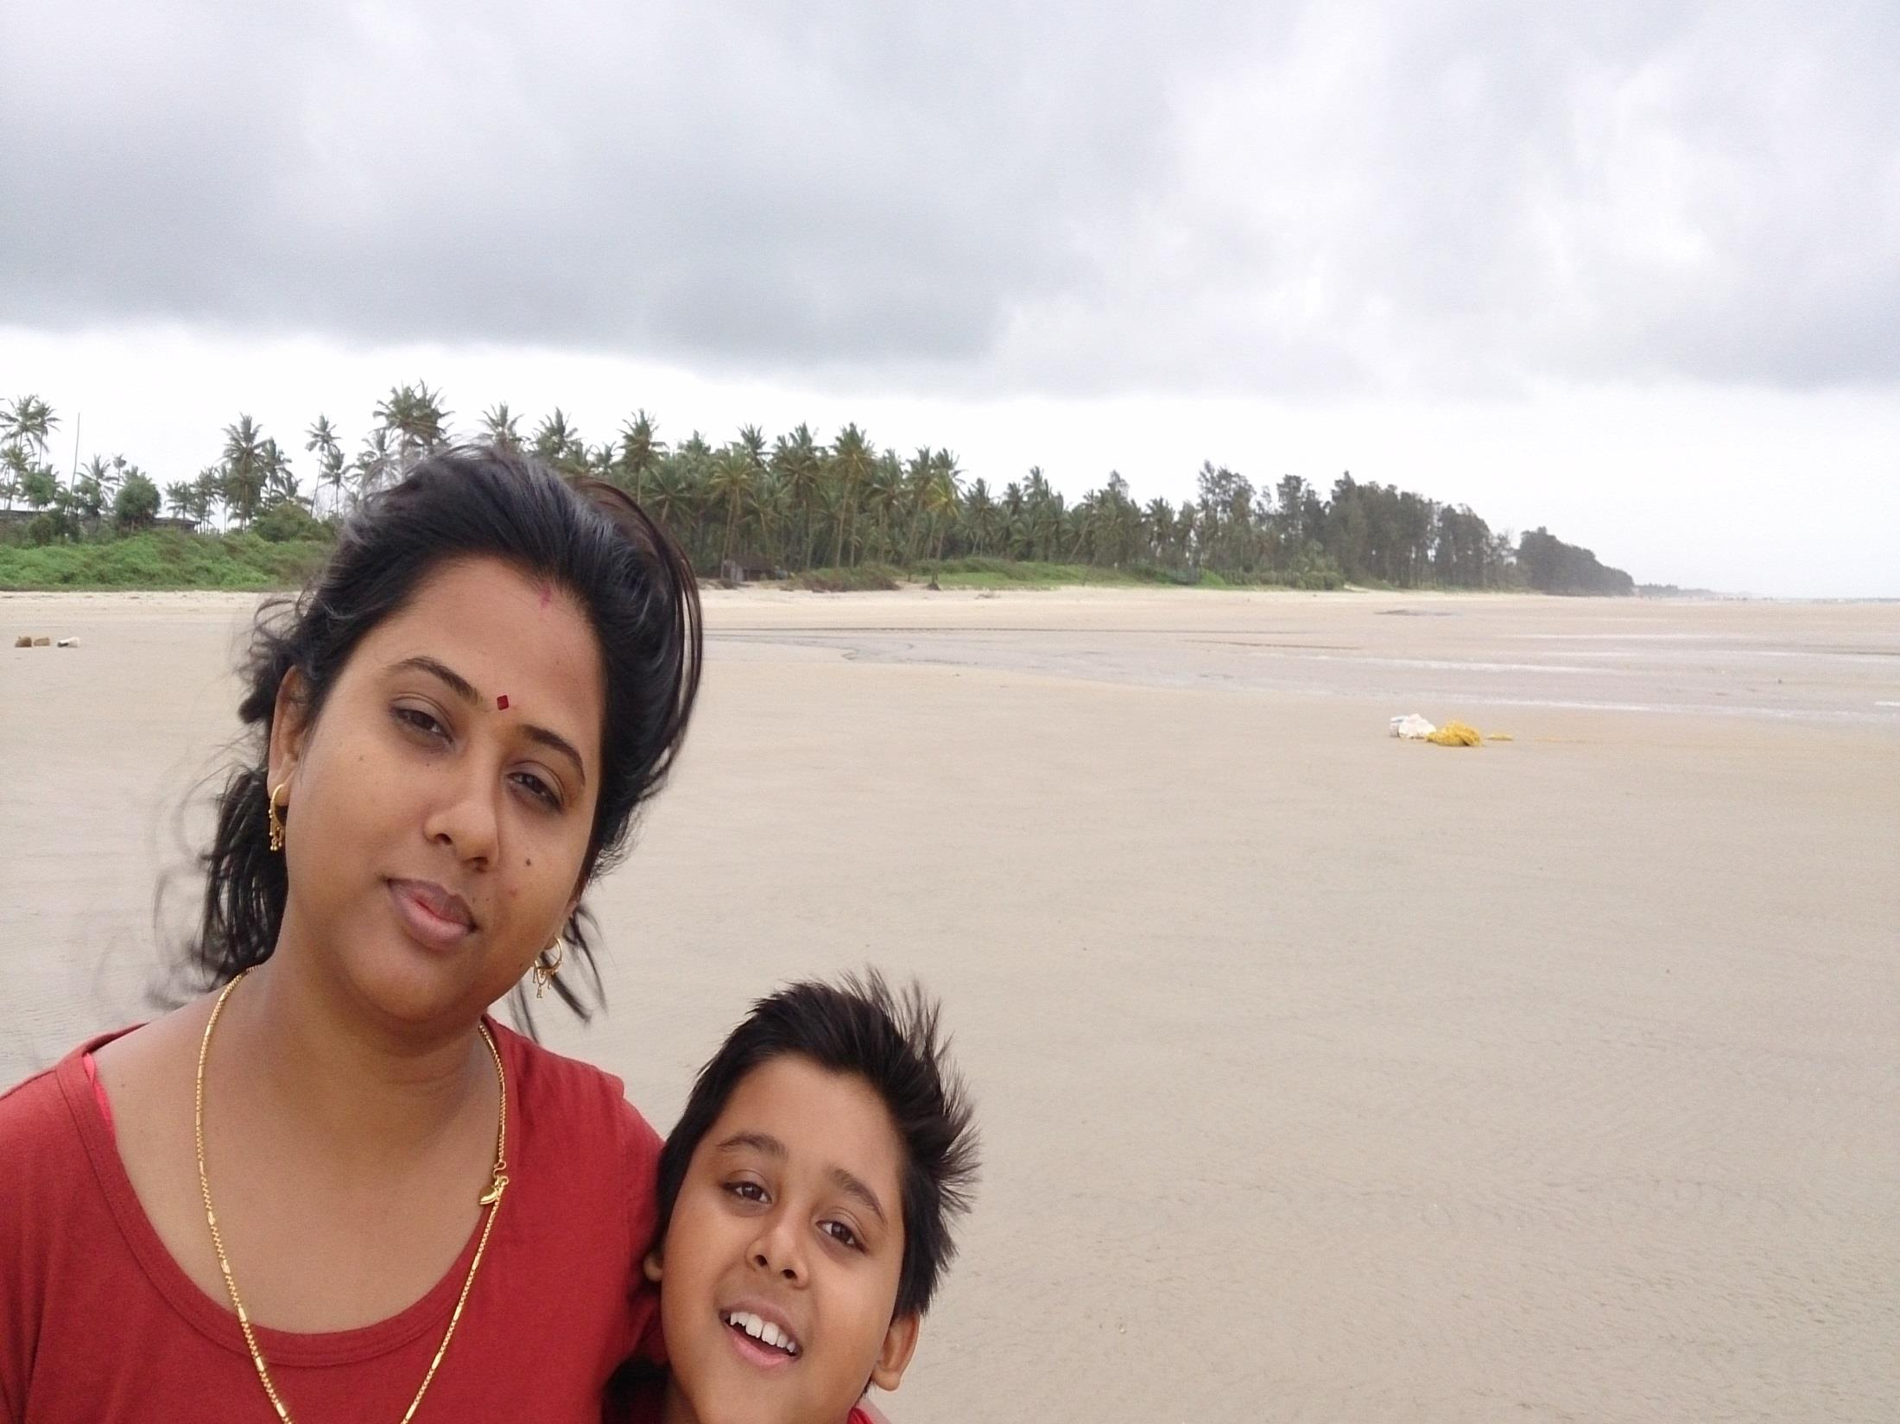
… it’s all about the OOMPH factor
Hidden Expectation In Project Management
Intangible Benefit Spiral
Failure to Success Transformation
Brand Retention
Notes:
Problem statement

Slide 21

… it’s all about the OOMPH factor
Hidden Expectation In Project Management
Intangible Benefit Spiral
Failure to Success Transformation
Brand Retention
Notes:
Problem statement

Slide 22
Stake Holder Delight
Monitoring
Collaboration
Transformation
Sharing
Return on Investment
Transition

